Slide 1

P250- Resume Classification
Presenting By: Group 2

Slide 2
Group 2 Mentor’s Names: Rohit Mishra and Priyanka Mam
Team Member’s : Mr. Nishant Dalvi
Mr. Shubham Tiwari
Mrs. Harshali Singh
Mrs. Safreena Kh
Mr. Akash S
Mr. Pramesh Monteiro
Mr . Ashutosh Patil

Slide 3
Objective :
The document classification solution should significantly reduce the manual human effort in the HRM. It should achieve a higher level of accuracy and automation with minimal human intervention Sample Data Set Details: Resumes and financial documents

Slide 4
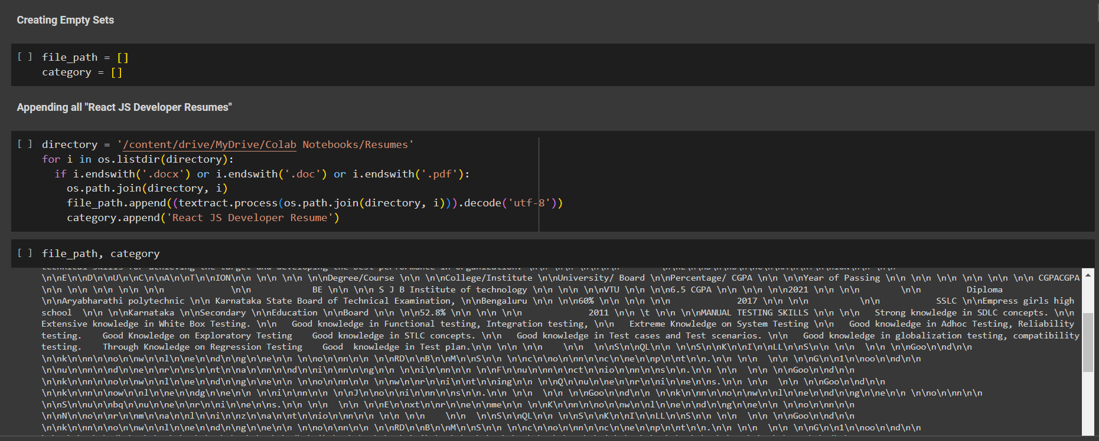
Exploratory Data Analysis :

Slide 5
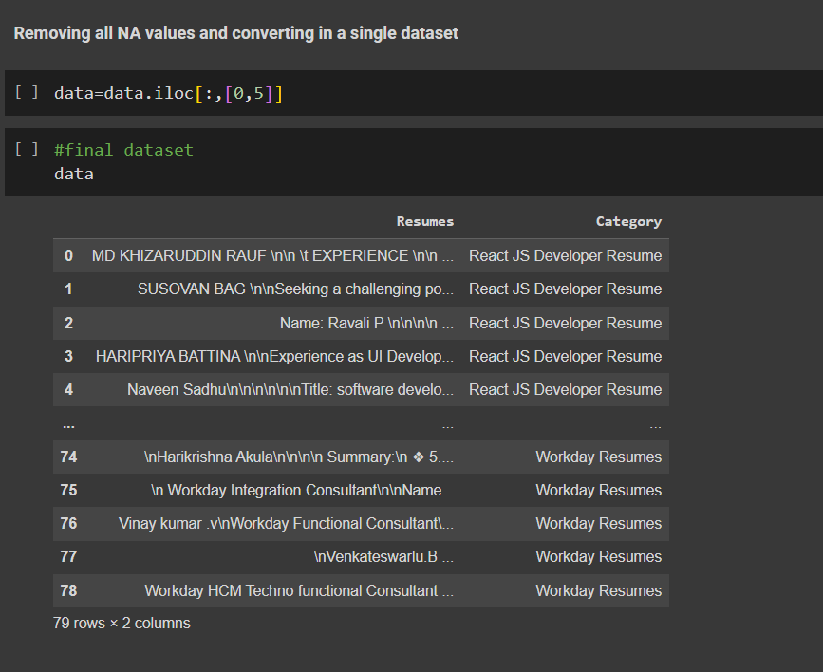
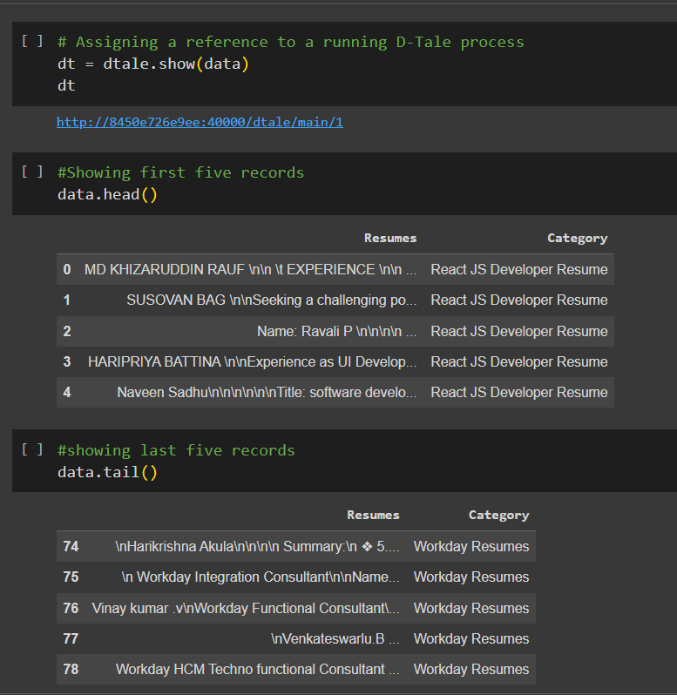

Slide 6
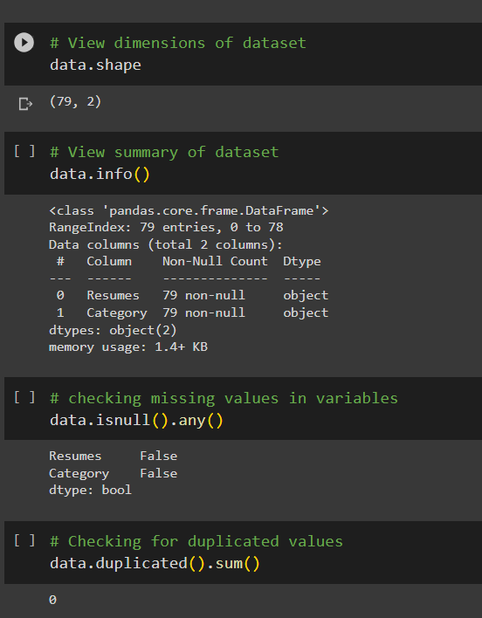
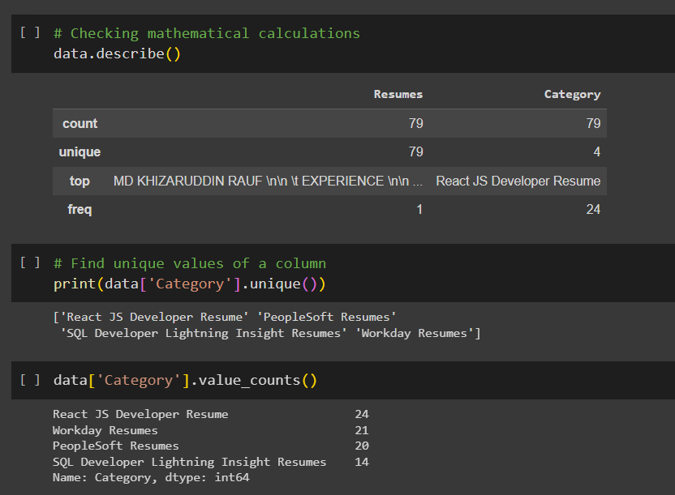

Slide 7
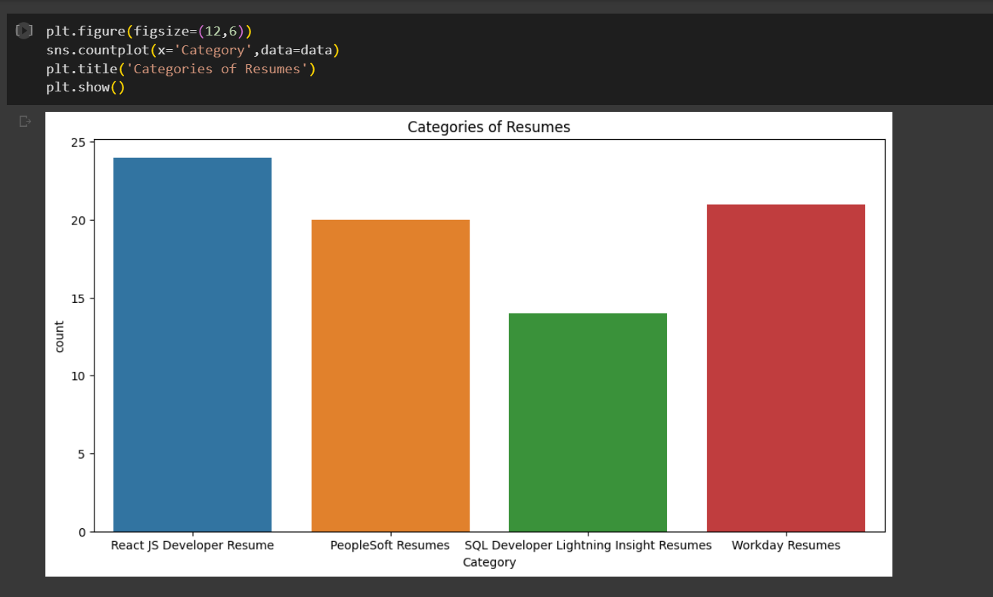

Slide 8
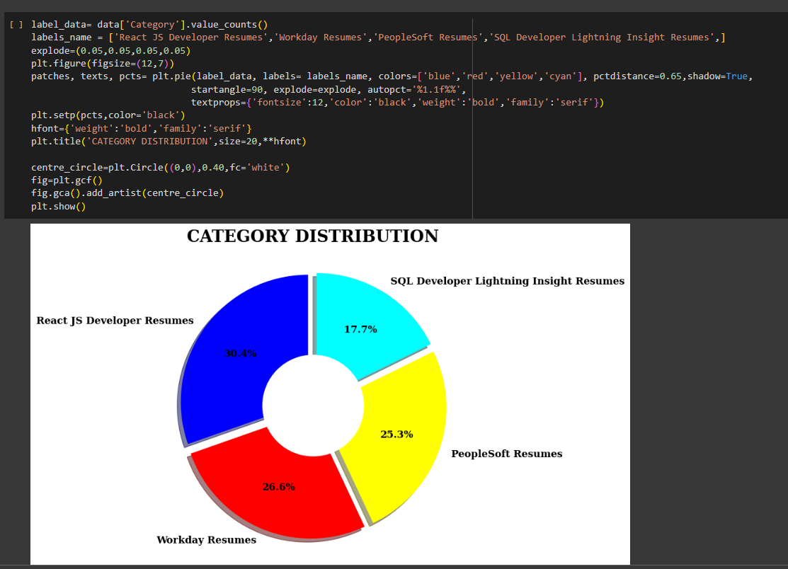

Slide 9
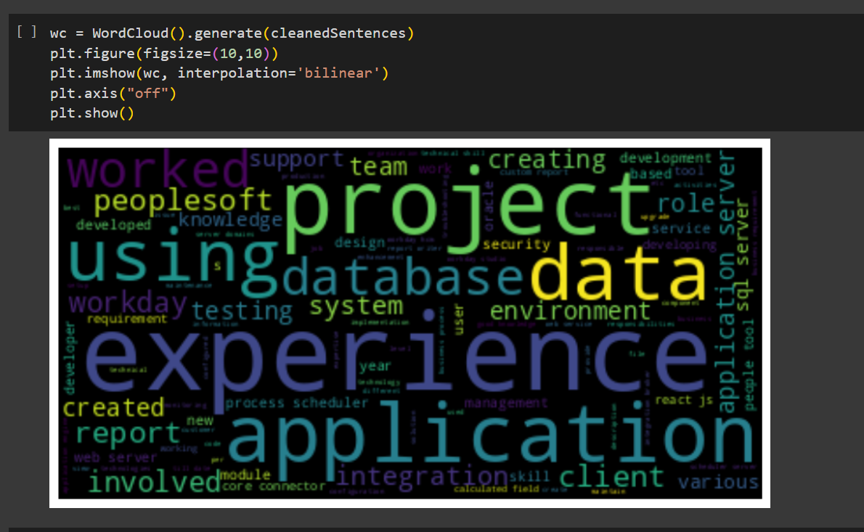

Slide 10
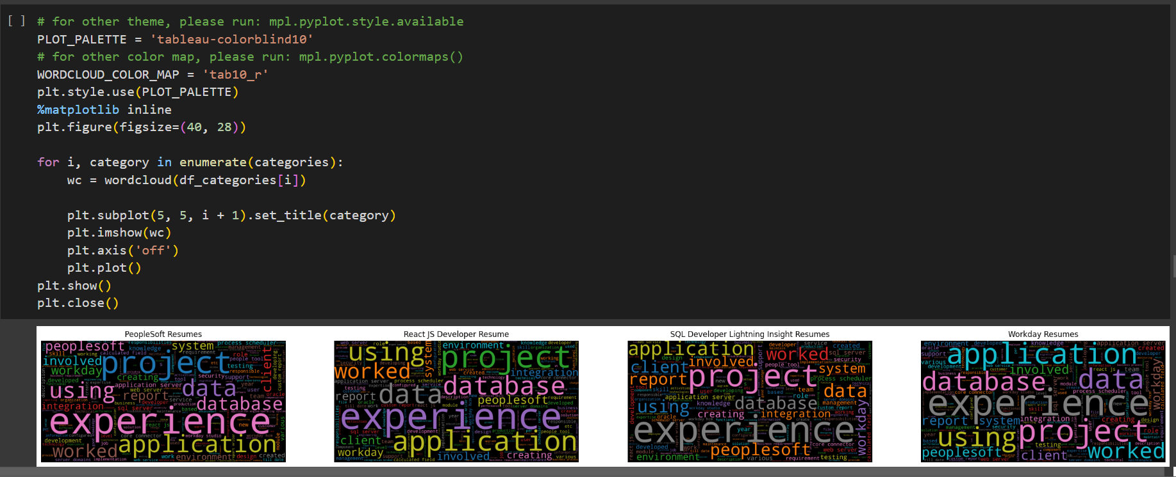

Slide 11
Model Building
Logistic Regression
Random Forest Classifier
Naïve-Bayes Classifier
Gradient Boosting Classifier
Decision Tree Classifier
Support Vector Classifier
Light Gradient Boosting Classifier
Xtreme Gradient Boosting Classifier

Slide 12
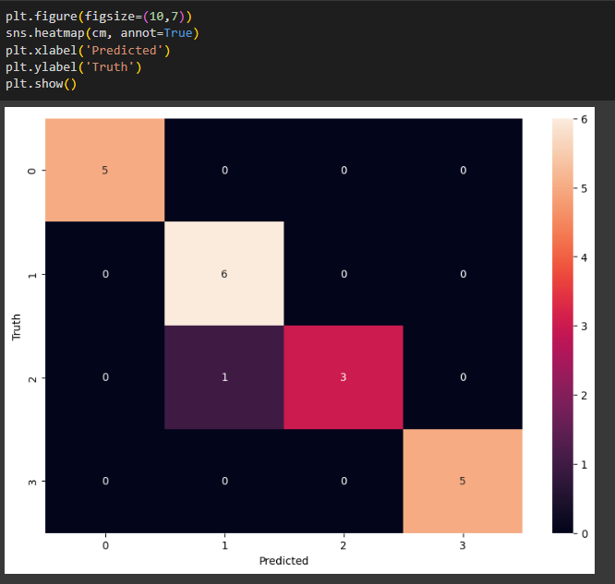
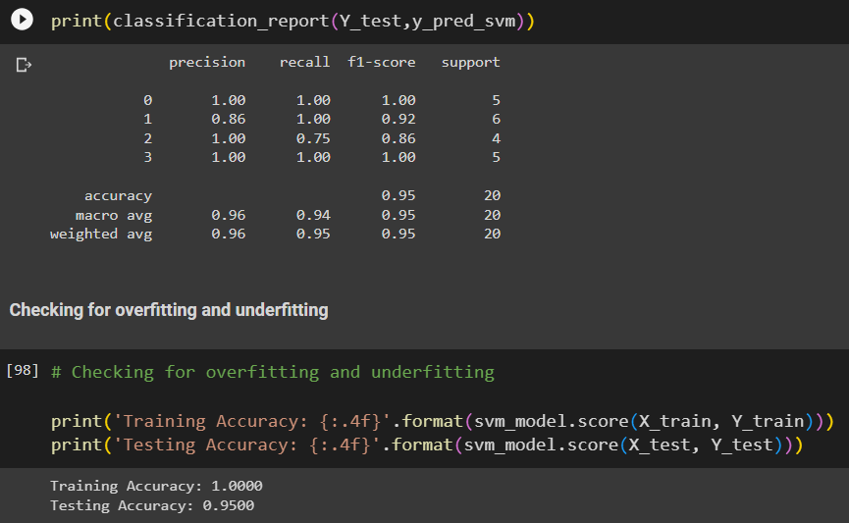
Support Vector Classifier

Slide 13
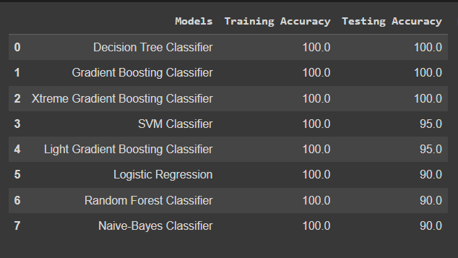
Combining All Models
Here support vector classifier has good training and testing accuracy. So, we can finalize this model for further deployment .

Slide 14
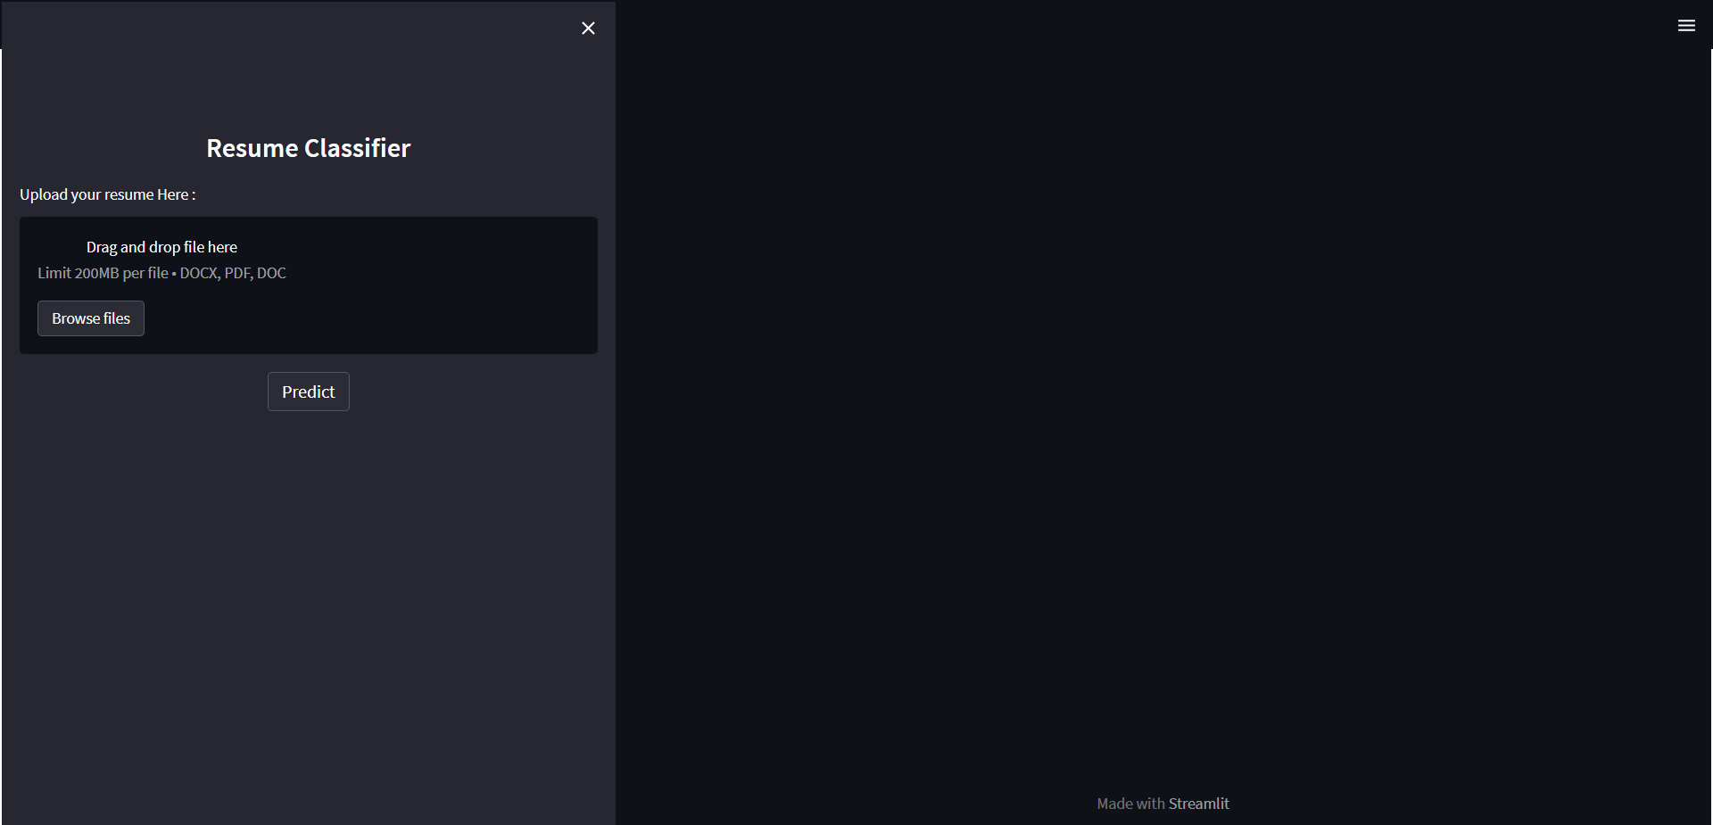
Model Deployment

Slide 15
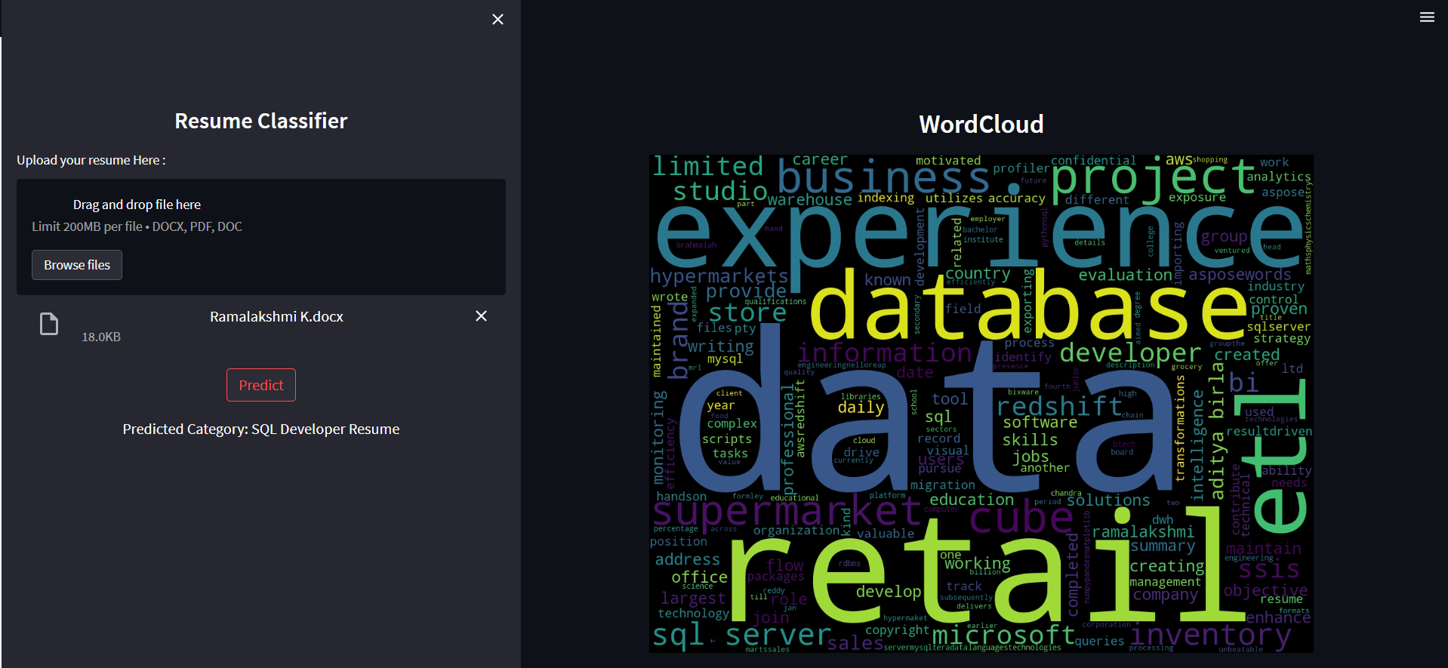

Slide 16
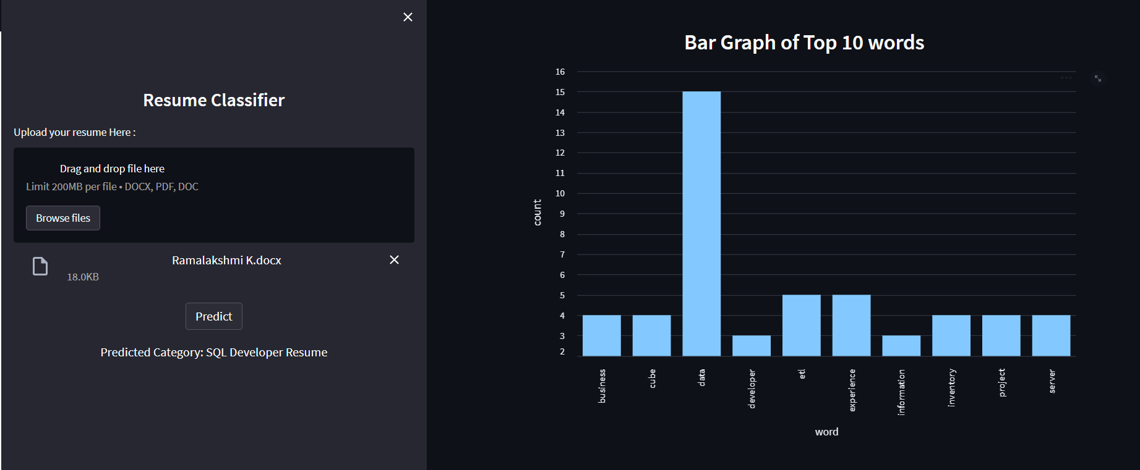

Slide 17
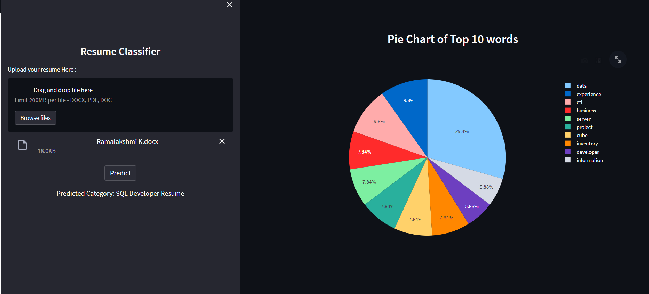

Slide 18
Thank You!

